Slide 1
TwinStrand Panel - v1
Jason Kunisaki
2/5/2021

Slide 2
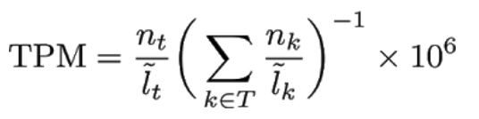
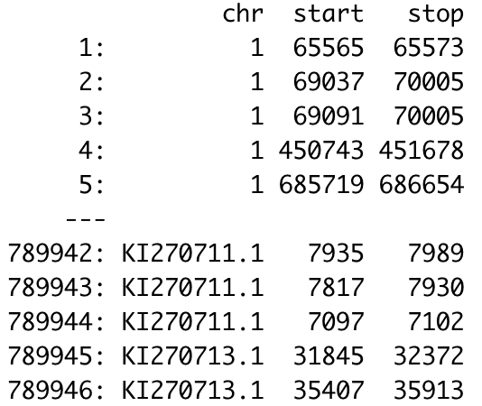


Important files
GTF file
gene_names
gene_ids
transcript_ids
exon positions
APPRIS file
Functionally important isoforms/transcripts
Proteomics
Cross-species conservation
GTEx file
Tissue specific gene expression
~330 testis samples
Manuel Rodriguez et al, 2017

Slide 3
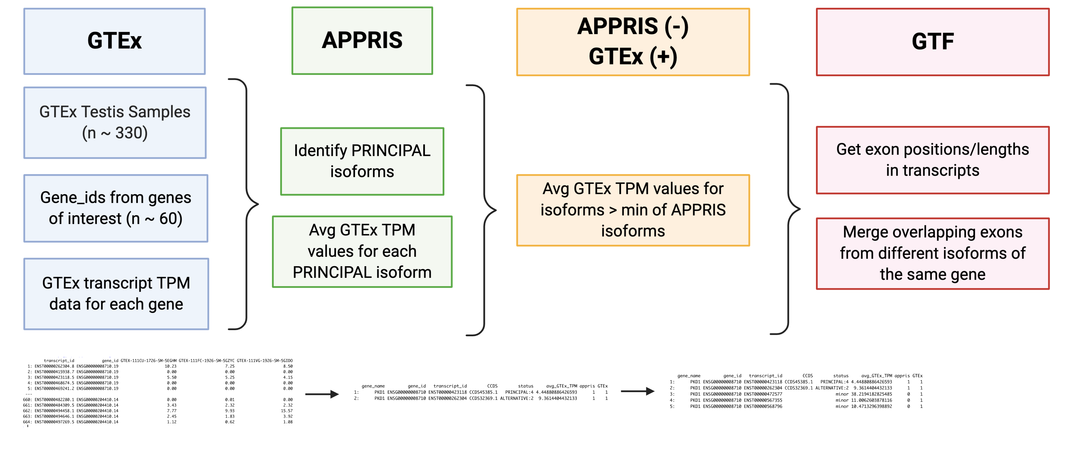
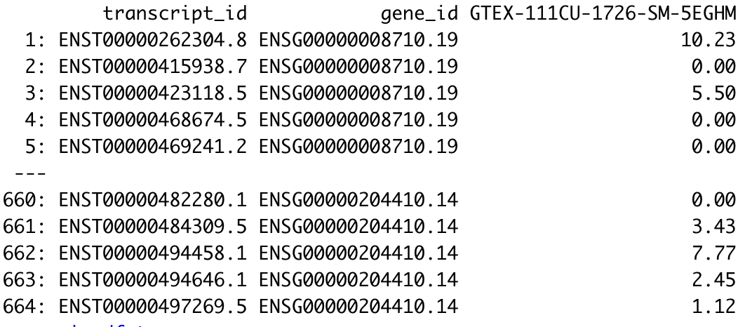
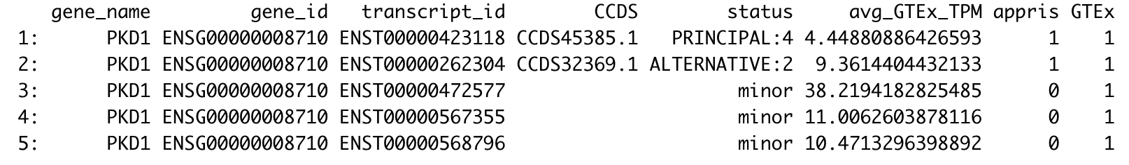
General Analysis Overview
*in testis

Slide 4
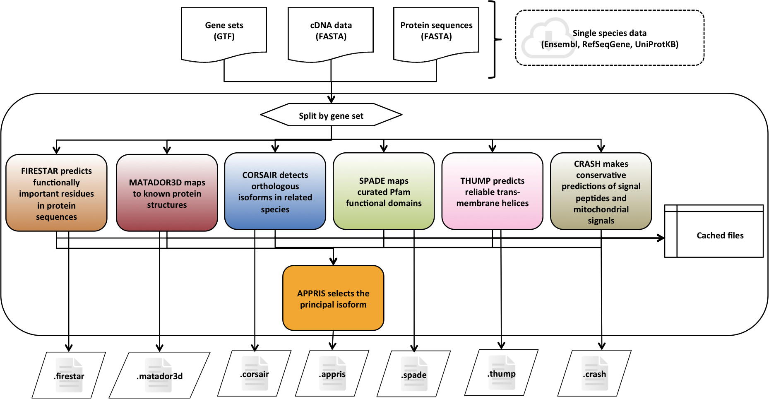
APPRIS – Functionally Important Isoforms

Slide 5
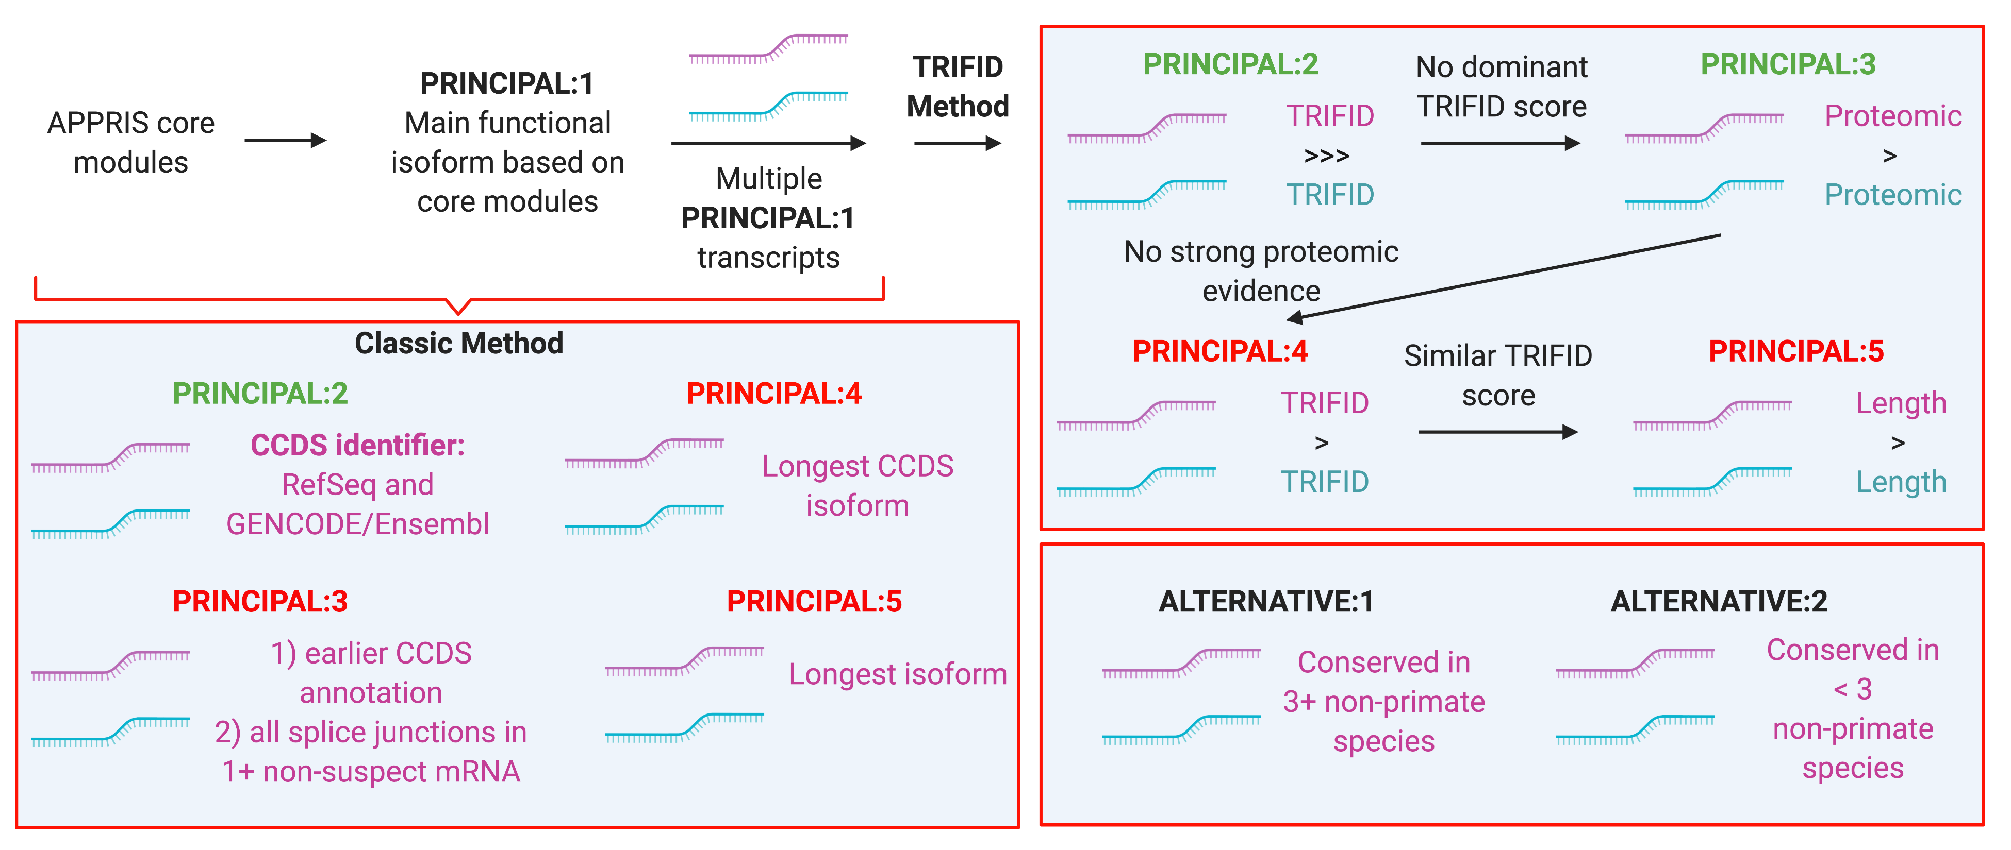
APPRIS – Principal Isoform Flags
NOTE:
Multiple transcripts can have same CoDing Sequence (CDS)

Slide 6
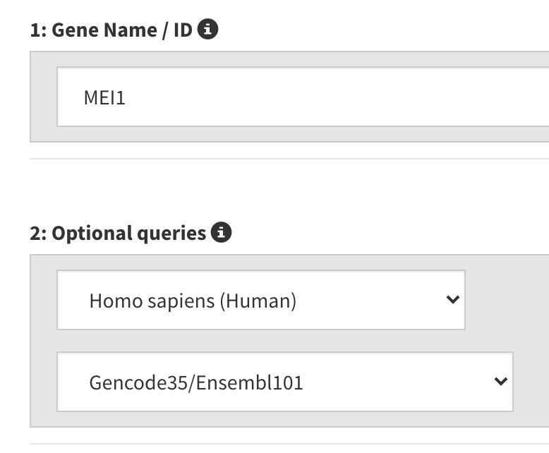
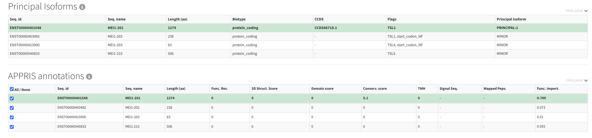
APPRIS – Example with MEI1
MEI1 Genome Browser Link

Slide 7
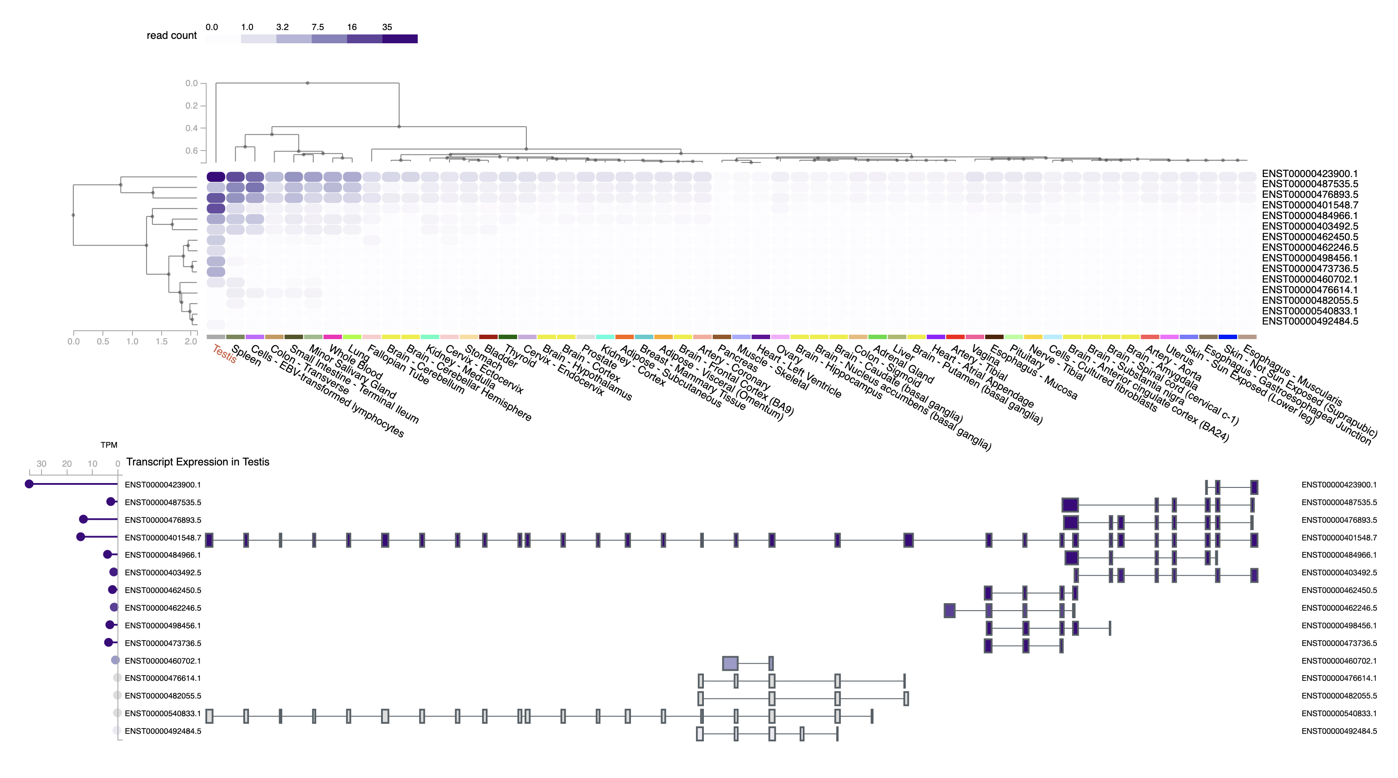
GTEx – Target Gene Expression in Testis
GTEx – Example with MEI1

Slide 8
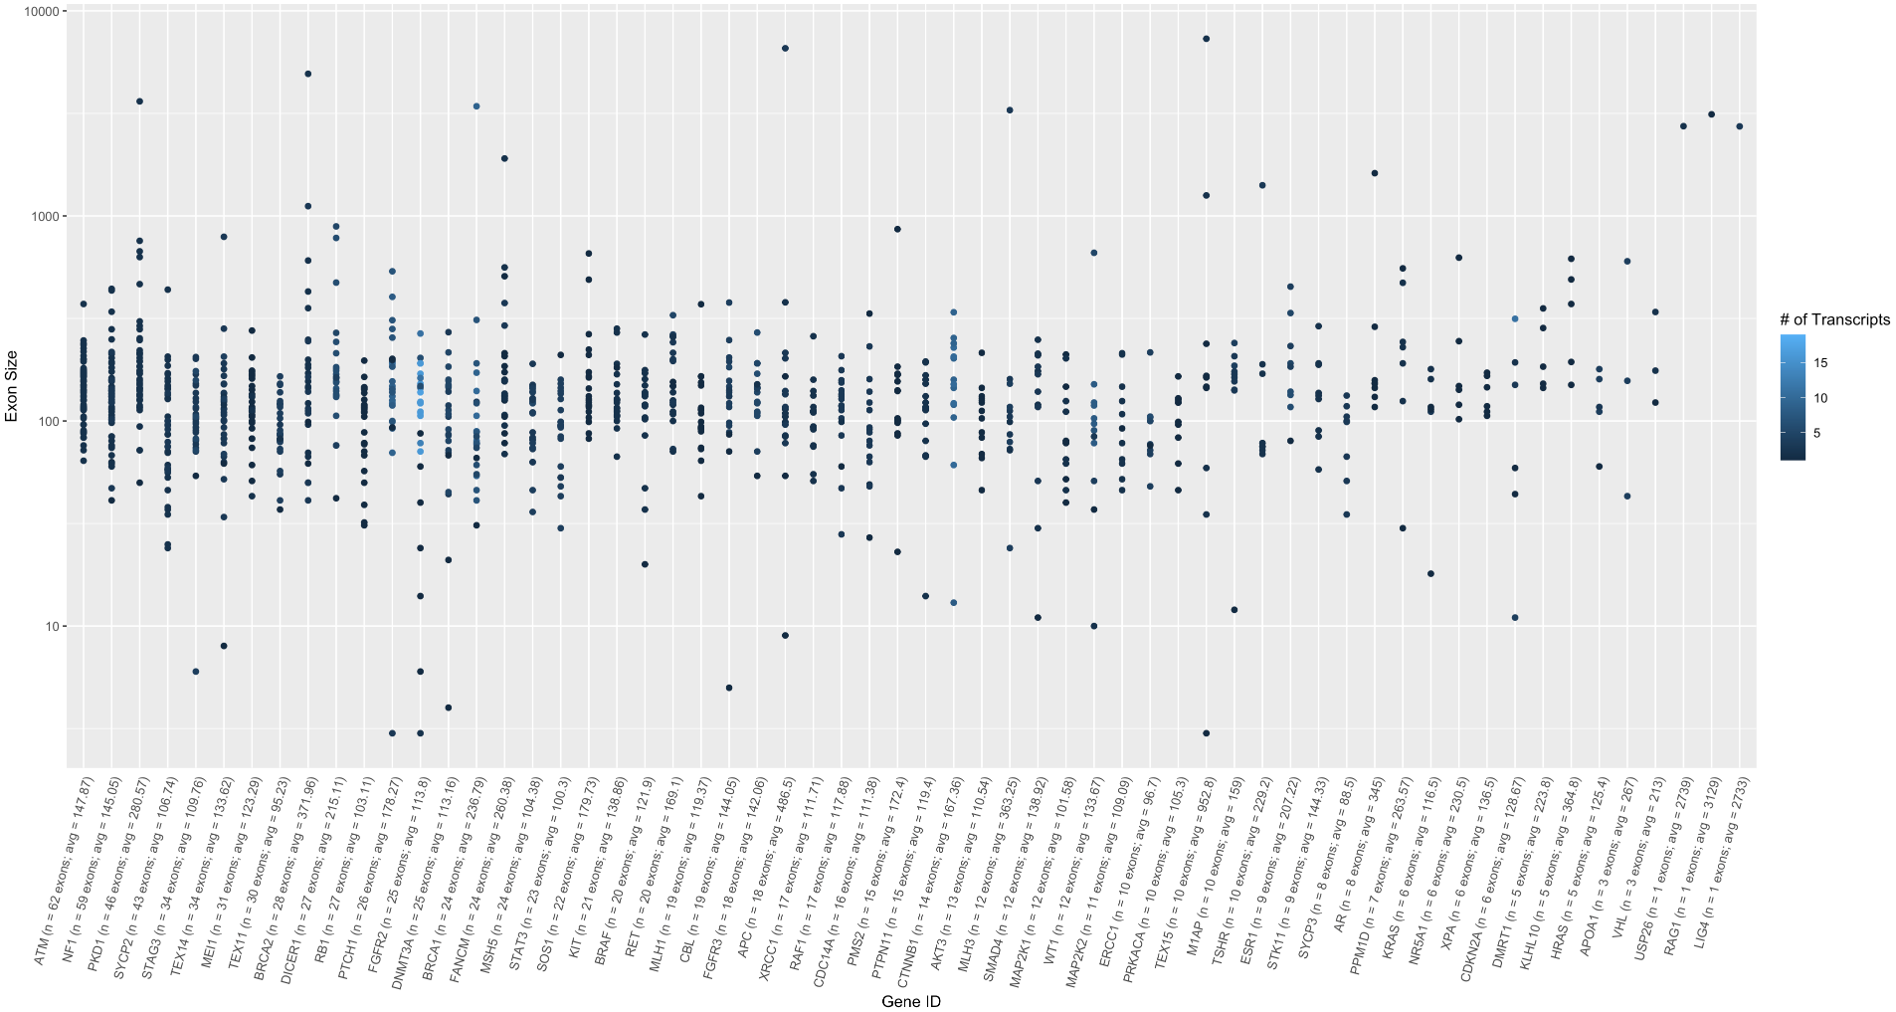
Look at genes that take up most space
Look in cBioPortal
Mark ones that have cancer hotspots/where they are in exonic space
For genes that are no: what are the functionally relevant exons → which ones have high GC/CpG content
Pull exons that have hotspots → intersect exons with MAF file → get mutation count per exon → sanity check
Notes:
Make another plot --> proportion of total # of bp that each gene eats up

Slide 9
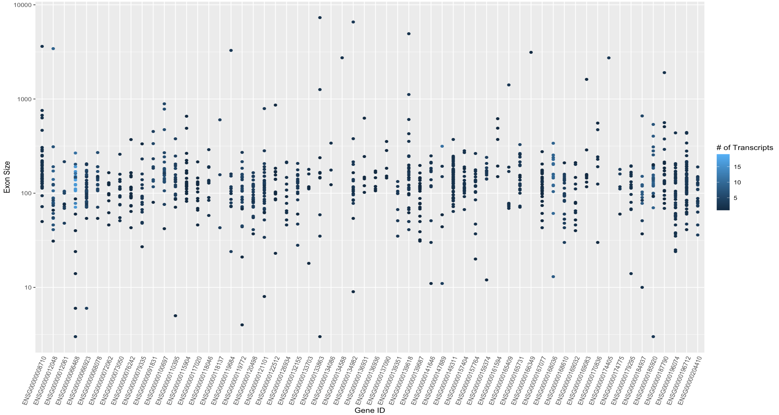
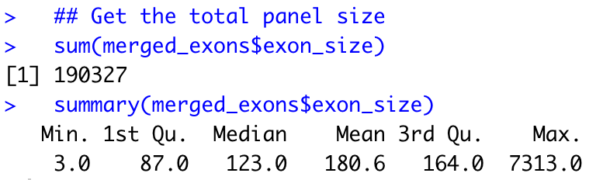
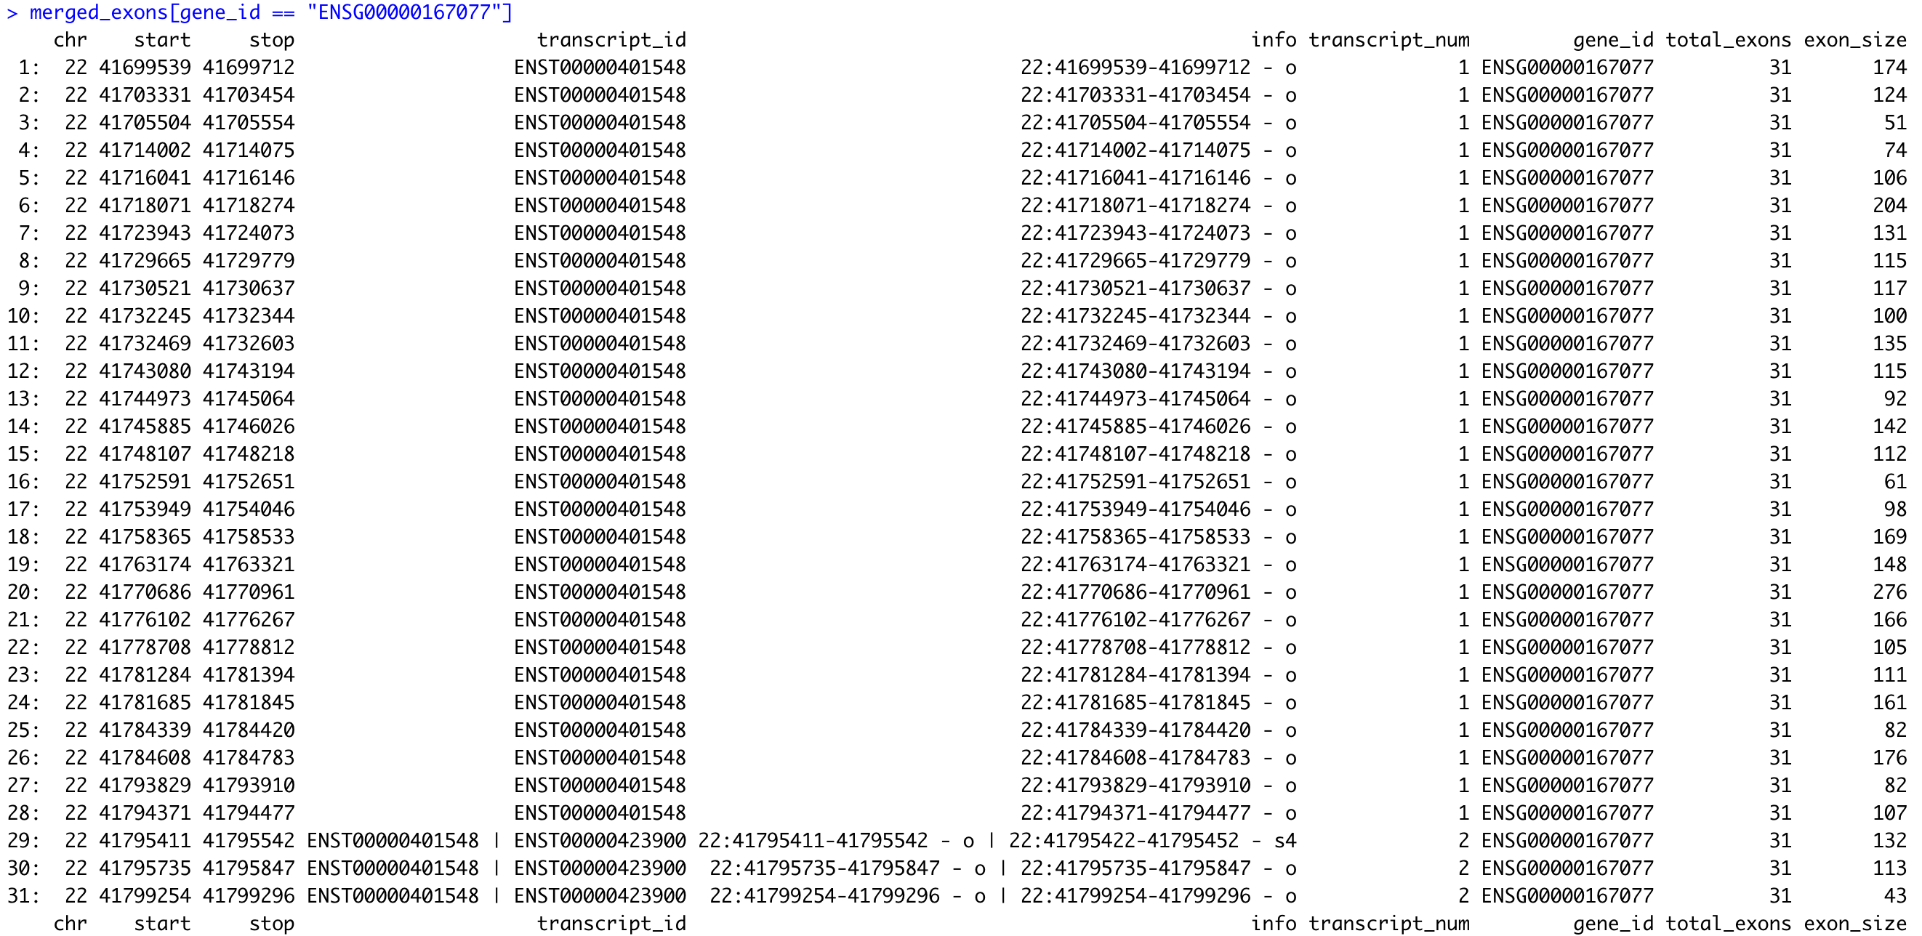
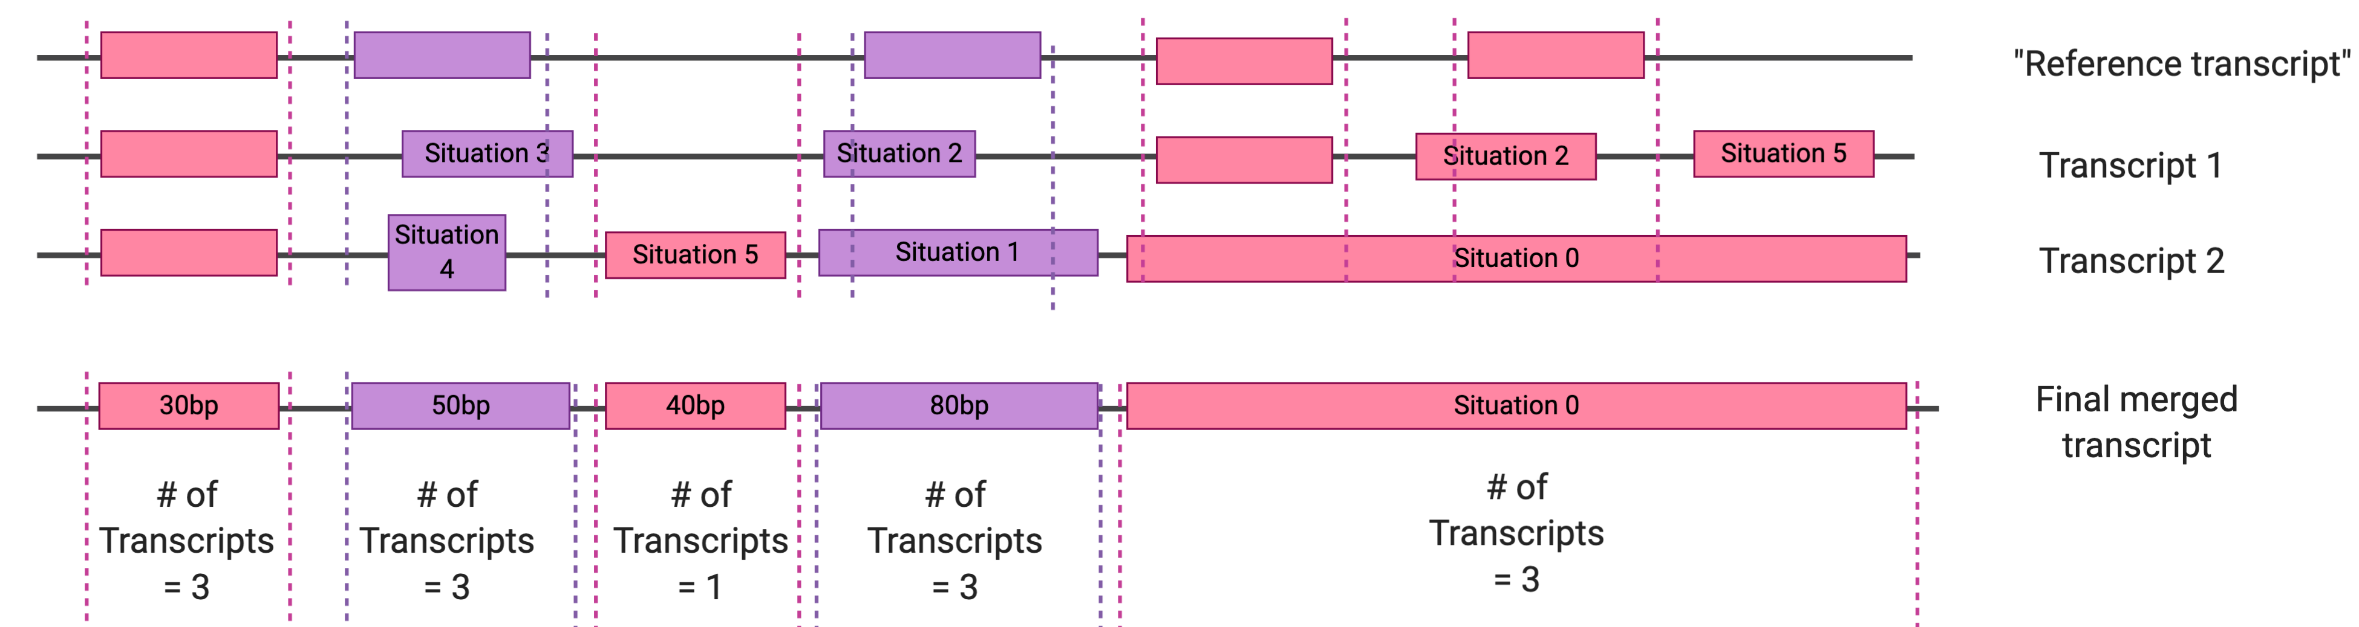

Slide 10
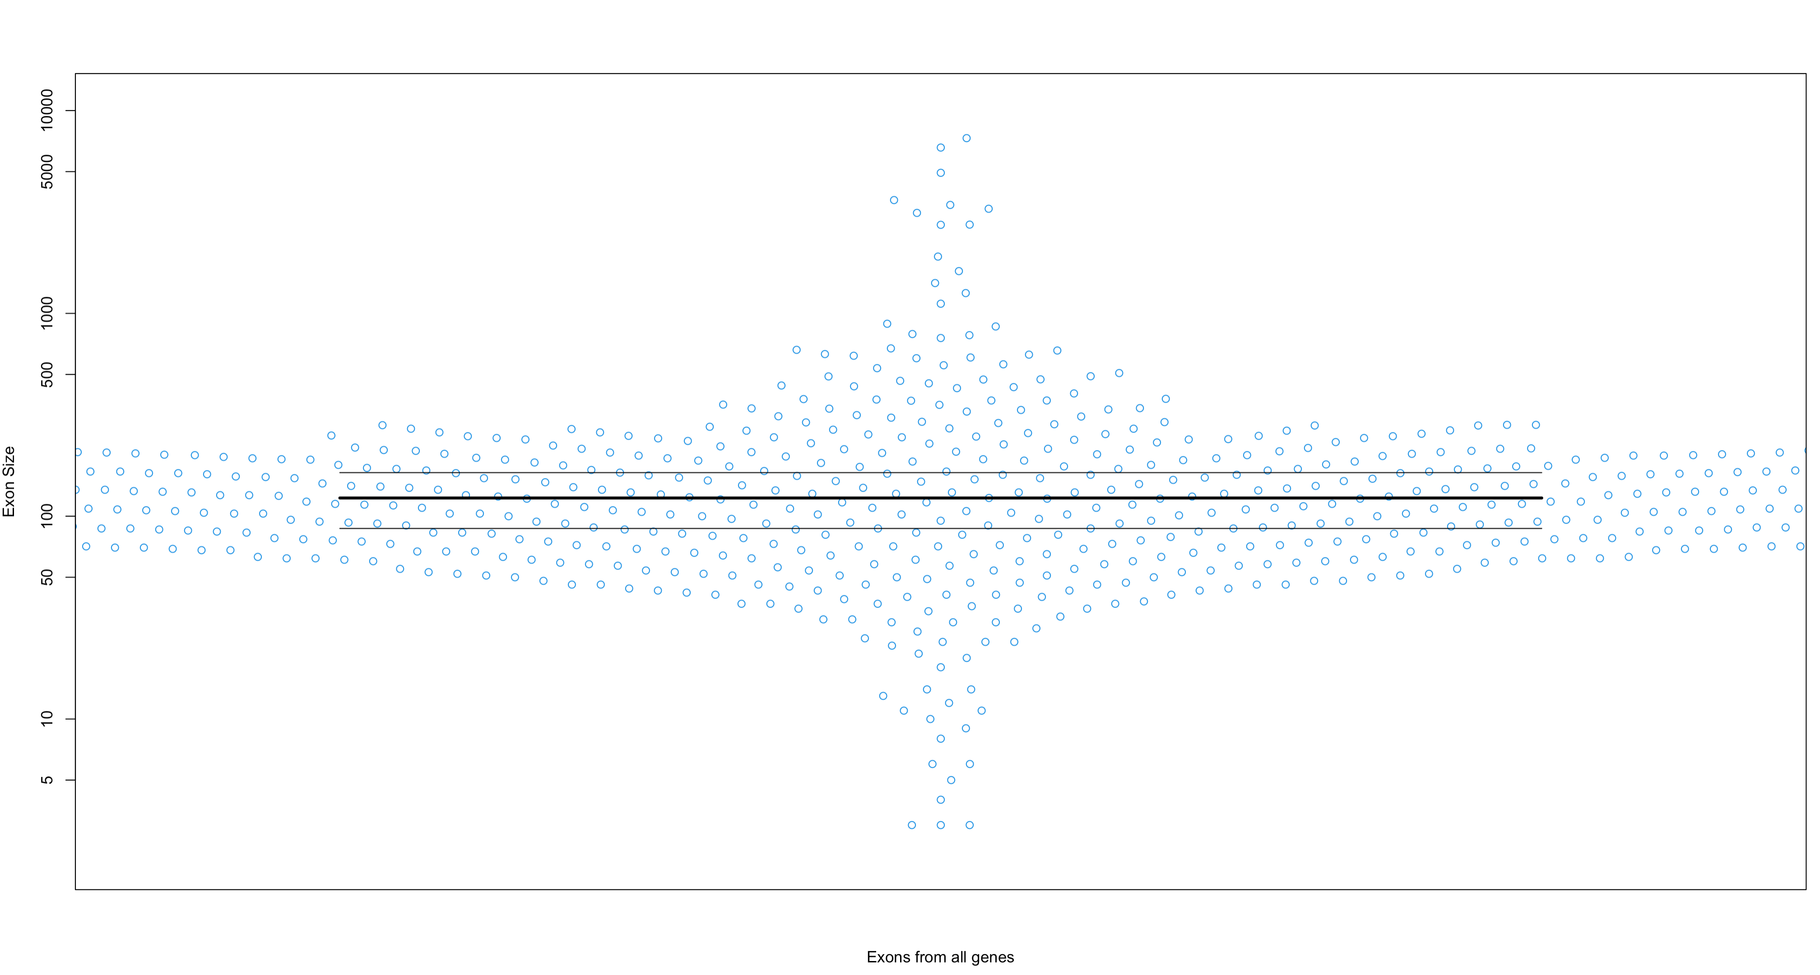

Slide 11
Caveats with the analysis
Difficult to compare TPM values across genes and samples (Zhao et al, 2020 → written by Pfzier)
Still need to check for many, many bugs
Does not include AZF genes → PING KI (want to know how many/how big)
Still includes all exons from large genes (e.g. BRCA1 and BRCA2)
Notes:
note how many samples have TPM values > 1

Slide 12
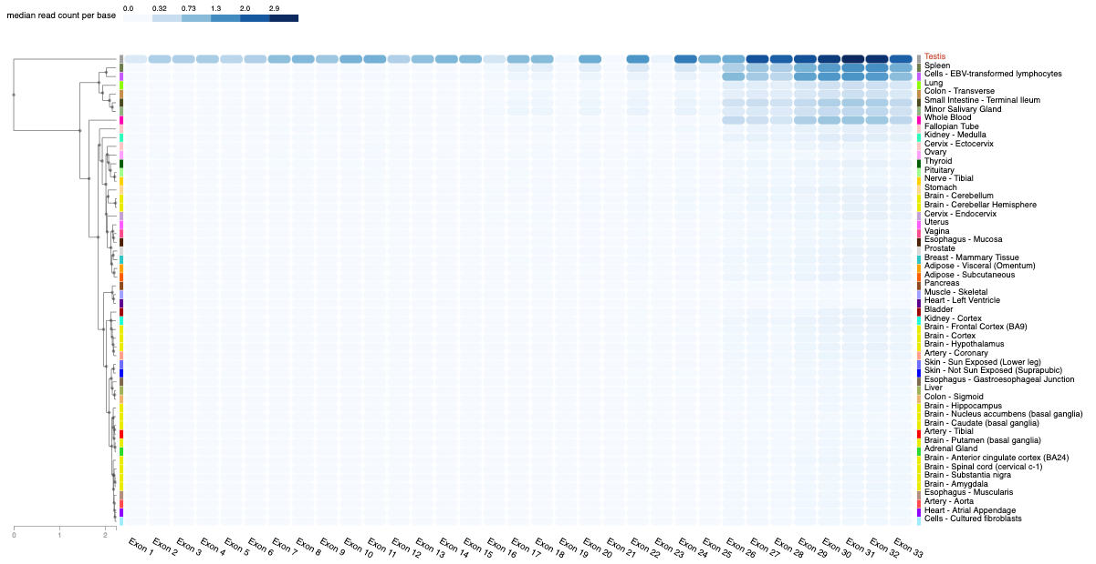
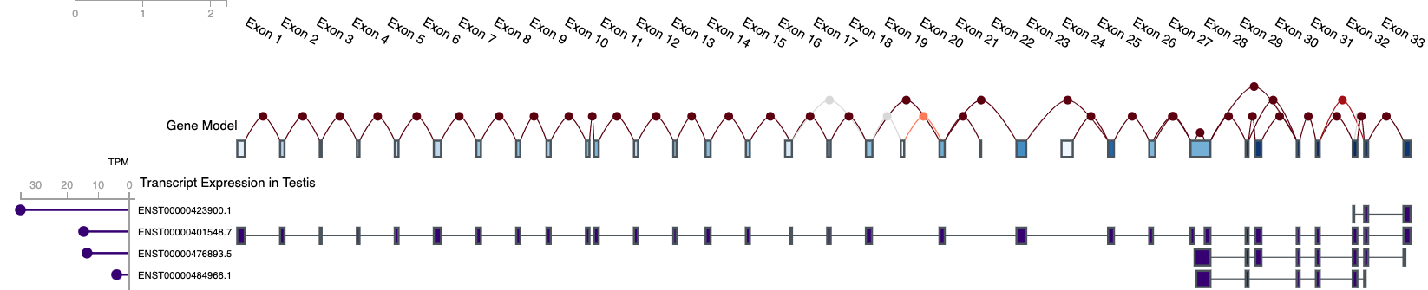
Next steps for TwinStrand panel design
How to prioritize exons:
Selfish mutations → use similar panel as Maher et al (https://genome.cshlp.org/content/28/12/1779/T1.expansion.html)
Cancer genes? Autism risk genes?
Cancer hotspot mutations? Any mutation in cancer gene?
COSMIC
cBioPortal
ClinVar
Exon expression from GTEx
Make sure testis samples from GTEx are from healthy men? Or still use men with testicular cancer (e.g. from cBioPortal)?
MEI1

